Slide 1
Platform Customization Lab
Intel Corporation
Software and Solutions Group

Slide 2
Platform Build Lab
Build Lab
System requirements:
  Microsoft Windows XP
  256MB+ System Memory
  500MB+ Free Space on Hard Drive
  Visual Studio .NET 2005 Professional or NET 2003

Slide 3
NT32 Emulation Lab Setup
Customizing Lab
System requirements:
  Microsoft Windows 2000/XP/2003
  256MB+ System Memory
  500MB+ Free Space on Hard Drive
  Visual Studio .NET 2003 or 2005 Professional
Unzip CD contains EDK and EFI-Shell (May have already been done in NT32 Lab First Day)
  Unzip the EDK-1.05.Zip to C:\Fw
  Unzip the EfiShell-1.05.Zip to C:\Fw\Edk\Other\Maintained\Application

Slide 4
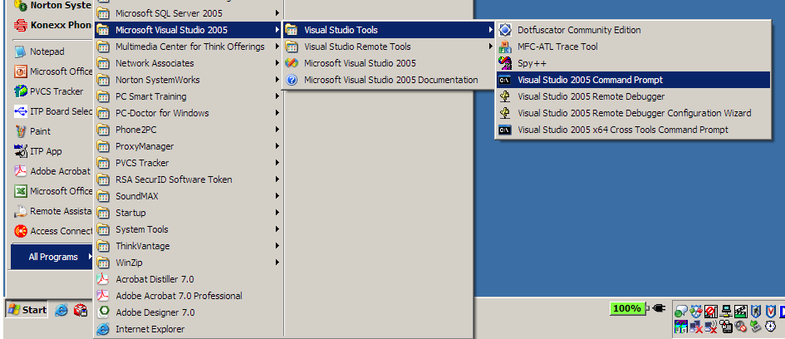
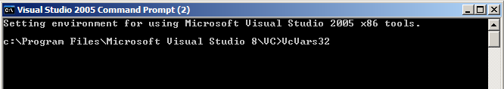
Compiler Environment
Build Lab
Use the Visual Studio command prompt to setup the proper compiler environment
Run VcVars32 at the CMD Window with VS 2005
3
4
5
2
6
1

Slide 5
NT32 Build Lab
Build Lab
CD C:\FW\Edk\Sample\Platform\Nt32\Build
Edit the Config.env file for VS 2005 Only change the following line to “YES”
  USE_VC8 = YES
Build the NT32
  set EDK_SOURCE=C:\FW\EDK
  CD C:\FW\Edk\Sample\Platform\Nt32\
  Build
Wait for Build to finish

Slide 6
Setting Up The Environment
Build Result
Local disks & folders can be mounted as file systems under the NT32 environment
Window names can be modified
The System.cmd in the Build directory Examples:
  Map a 1.44MB Floppy:
  set EFI_WIN_NT_PHYSICAL_DISKS=a:RW;2880;512
  Set the window name:
  set EFI_WIN_NT_UGA="UGA Window 1"
  Map a system directory as a file system under EFI NT32:
  set EFI_WIN_NT_FILE_SYSTEM=c:\virtual (needs to a mkdir c:\virtual before you nmake run)
  Or set it to . to point to the current build dir where all the .efi files are at. This will allow you to run the .efi files from FS0:
Run System.cmd before running nmake run to get file systems

Slide 7
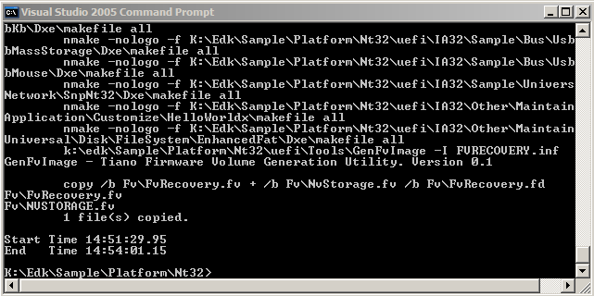
NT32 Build Lab Continued
Build Time stamp
After BUILD is complete
  CD Uefi
  System
  Nmake Run

Slide 8
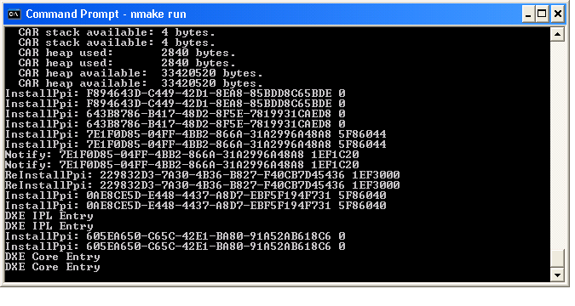
nmake run
Build Result
Start Emulation
  Emulation runs as Windows application
  Reset vector code for desktop/server replaced with Windows application startup code
  Startup code initializes framework and calls dispatcher to start loading drivers

Slide 9
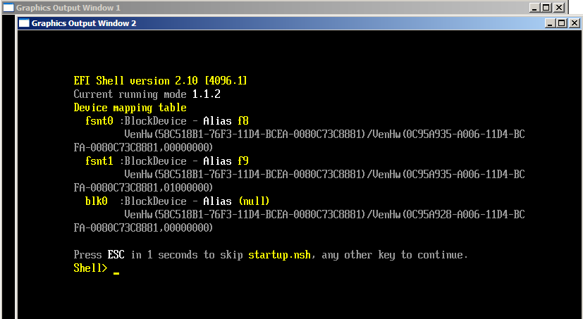
Boot to the EFI Shell
Customizing Lab
Load the EFI Shell
Switch to fsnt0: for the local disk
  Mapped to EFI_WIN_NT_FILE_SYSTEM

Slide 10
Exiting NT32 Environment
Customizing Lab
Hit “X” in upper right to close emulated console(s) – “Graphics Output Window 1” “Graphics Output Window 2”
When all are closed select command shell prompt window with cursor then Ctrl-C twice to get control back to Windows command shell Prompt
Or execute reset.efi from internal EFI shell

Slide 11
Breakpoint Debugging
Customizing Lab
Add a breakpoint to an application & rebuild NT32
  Edit the file FW\Edk\Sample\Platform\Generic\Dxe\UefiPlatformBds\FrontPage.c
  Go to line ~239 or search for “// Boot Maintenance Manager” and Add the line
  EFI_BREAKPOINT();
  Breakpoint will invoke debug in Visual Studio

Slide 12
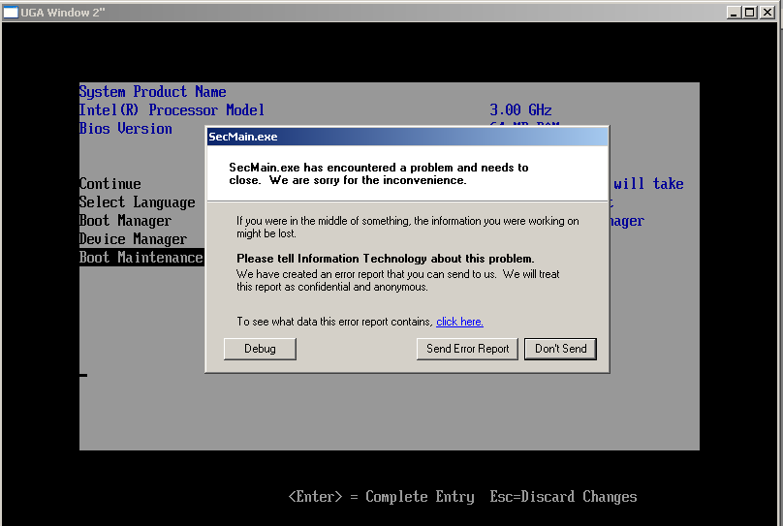
Microsoft Studio Debug
Customizing Lab
You will be prompted to run the Microsoft Studio Debugger

Slide 13
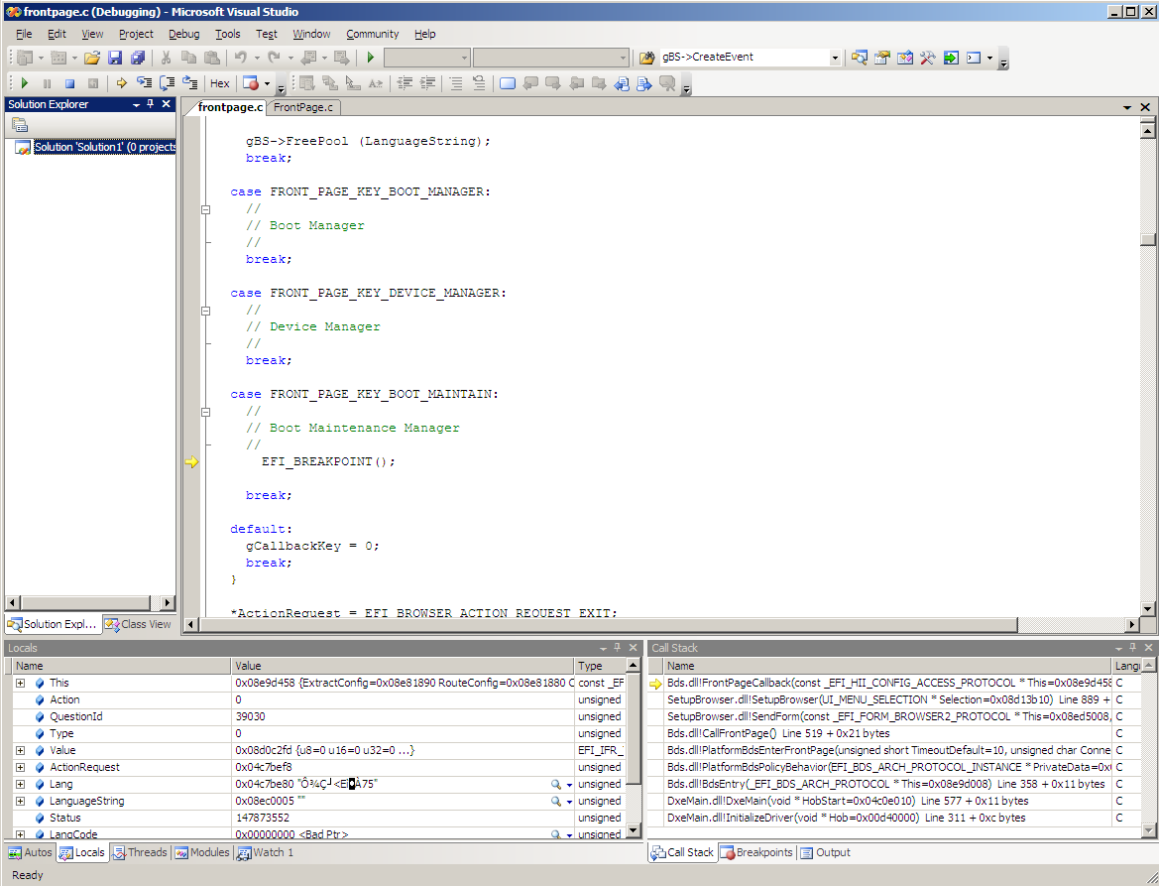
Breakpoint Debugging
Customizing Lab
Step around breakpoint

Slide 14
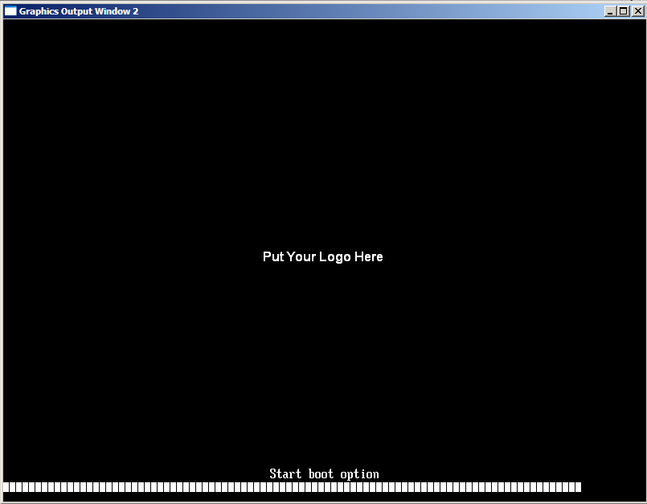
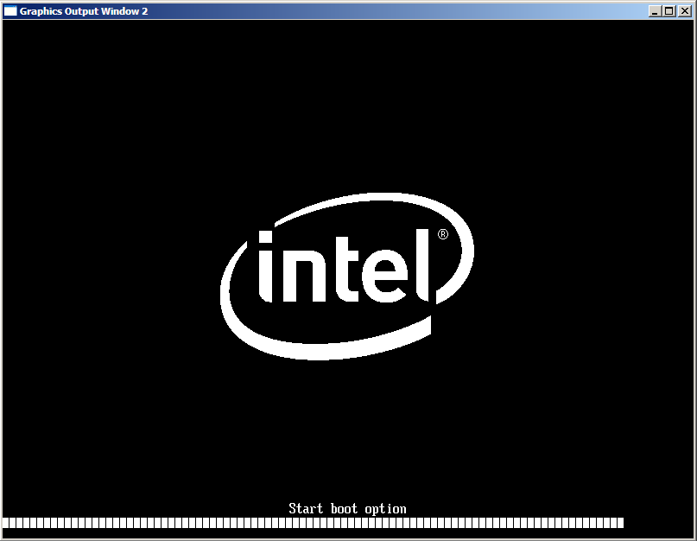
Change the splash logo
Customize Lab

Slide 15
Step-by-step of changing logo
Customizing Lab
Create a 800x600, 16 color BMP file as the new logo file (NewLogo.bmp)
Example BMP in CD \class\edk\logo\logo.bmp
Or use Microsoft Paint to alter the logo.bmp to make a new logo.bmp file (see dir below)
Overwrite Logo.bmp with your New Logo.bmp at C:\FW\Edk\Sample\Platform\Generic\Logo
Delete the logo.bin file in the directory:
c:\fw\Edk\Sample\Platform\Nt32\uefi\IA32\Sample\Platform\Generic\Logo
In the Command prompt window:
  CD C:\Fw\Edk\Sample\Platform\Nt32\
  Build
After the build process successfully completes
  CD Uefi
  nmake run
You will see the new splash logo

Slide 16
Setup Changes in the Framework
Customizing Lab
Two types of files are used to define the setup interface in the Framework
UNI
  UNICODE string definitions
  Associates string with a “string token”
VFR
  Formset definitions, defining the layout of setup screens
  References “string tokens” in UNI files

Slide 17
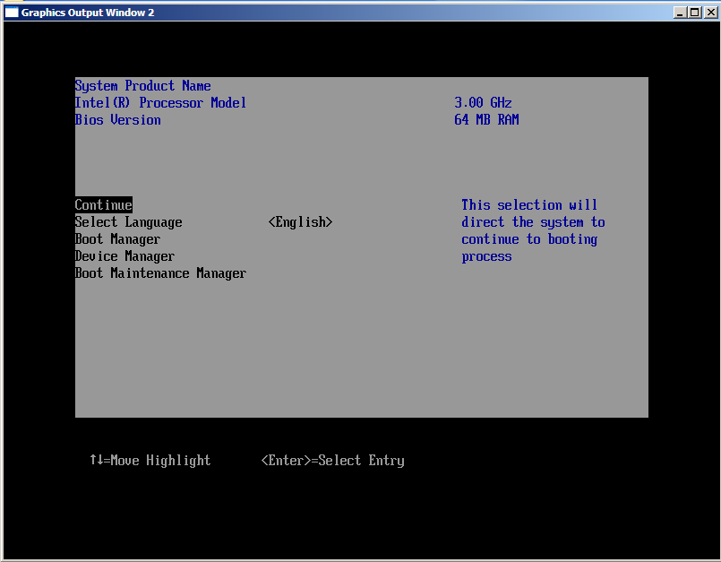
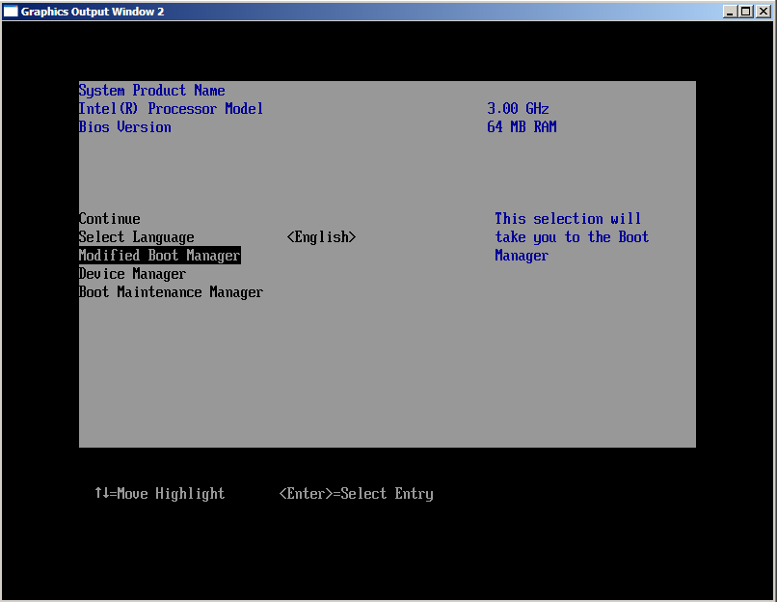
Change Boot Manager String
Customizing Lab

Slide 18
Change String: Step-by-Step
Customizing Lab
Find #string STR_BOOT_MANAGER, the string define in C:\FW\Edk\Sample\Platform\Generic\Dxe\UefiPlatformBds\
FrontPageStrings.uni
Change string definition from “Boot Manager” to “Modified Boot Manager String”
Save FrontPageStrings.uni
In the Command prompt window:
  CD C:\Fw\Edk\Sample\Platform\Nt32\
  Build
After the build process successfully completes
  CD Uefi
  nmake run
You will see the new “Modified Boot Manager” Menu line
This does not require a change to the VFR file

Slide 19
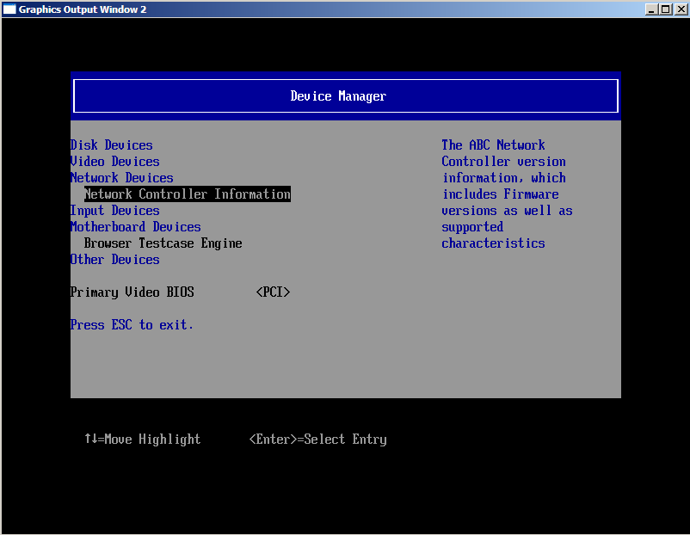
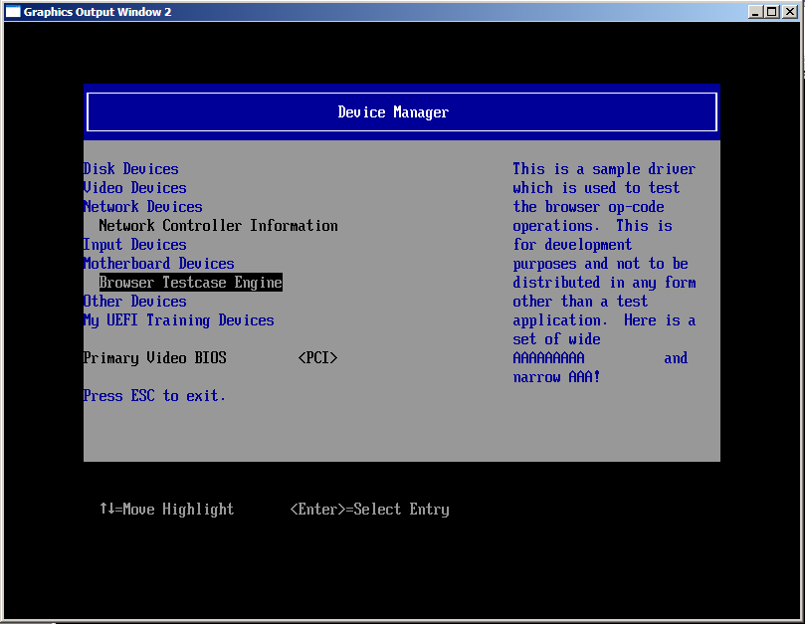
Add a New Device to the Device Manager Menu
Customizing Lab

Slide 20
Adding a String: Step-by-Step –Lab 1
Customizing Lab
Edit the file C:\FW\Edk\Sample\Platform\Generic\Dxe\UefiPlatformBds\DeviceMngrDeviceManagerStrings.Uni
  - Add “string token” (Note: leave the empty string as last string)
#string STR_TRAINING_DEVICE_1 #language eng "My UEFI Training Devices"
Hint: Class CD contains the finished Edits for this lab

Slide 21
Adding a String: Step-by-Step
Customizing Lab
Edit the file C:\FW\Edk\Sample\Platform\Generic\Dxe\UefiPlatformBds\DeviceMngr DeviceManagerVfr.Vfr
  - Add a new device class
Edit the (SAME) file C:\FW\Edk\Sample\Platform\Generic\Dxe\UefiPlatformBds\DeviceMngr DeviceManagerVfr.Vfr
  - Add a new label entry after the label EFI_OTHER_DEVICE_CLASS
#define LABEL_VBIOS 0x0040
#define EFI_TRAINING_DEVICE_CLASS 0x0080
label EFI_OTHER_DEVICE_CLASS;
// label LABEL_END;
label EFI_TRAINING_DEVICE_CLASS;
label LABEL_END;

Slide 22
Adding a String: Step-by-Step
Customizing Lab
Edit the file C:\FW\Edk\Sample\Platform\Generic\Dxe\UefiPlatformBds\DeviceMngr\DeviceManager.c
  Add a new device class with the new string ~line 36
  Note that this new Device class will do nothing at this time but display the menu item
#define EFI_TRAINING_DEVICE_CLASS 0x0080
DEVICE_MANAGER_MENU_ITEM mDeviceManagerMenuItemTable[] = {
{ STRING_TOKEN (STR_DISK_DEVICE), EFI_DISK_DEVICE_CLASS },
{ STRING_TOKEN (STR_VIDEO_DEVICE), EFI_VIDEO_DEVICE_CLASS },
{ STRING_TOKEN (STR_NETWORK_DEVICE), EFI_NETWORK_DEVICE_CLASS },
{ STRING_TOKEN (STR_INPUT_DEVICE), EFI_INPUT_DEVICE_CLASS },
{ STRING_TOKEN (STR_ON_BOARD_DEVICE), EFI_ON_BOARD_DEVICE_CLASS },
{ STRING_TOKEN (STR_OTHER_DEVICE), EFI_OTHER_DEVICE_CLASS },
{ STRING_TOKEN (STR_TRAINING_DEVICE_1), EFI_TRAINING_DEVICE_CLASS}
};

Slide 23
Adding a String: Step-by-Step
Customizing Lab
Save all files and Build
In the Command prompt window:
  CD C:\Fw\Edk\Sample\Platform\Nt32\
  Build
After the build process successfully completes
  CD Uefi
  nmake run
Select the “Device Manager” menu
You will see the new device item in the menu

Slide 24
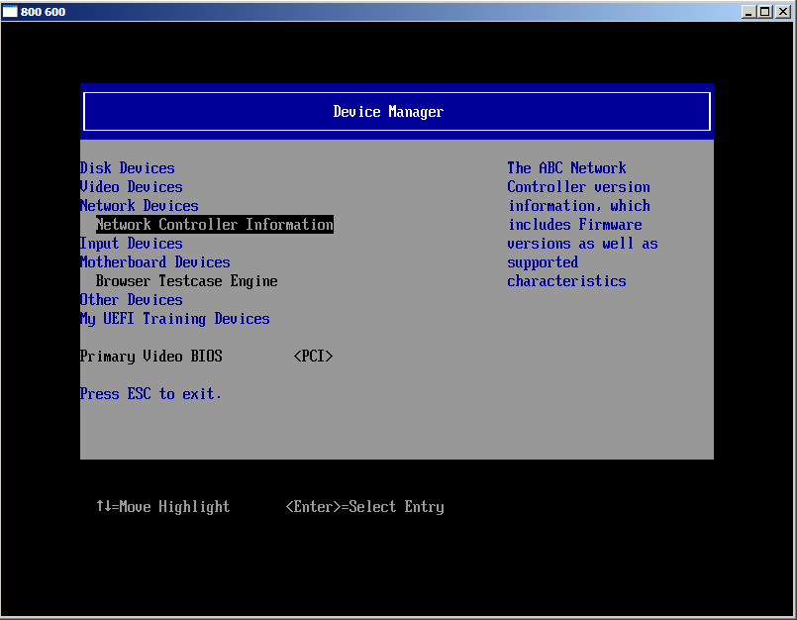
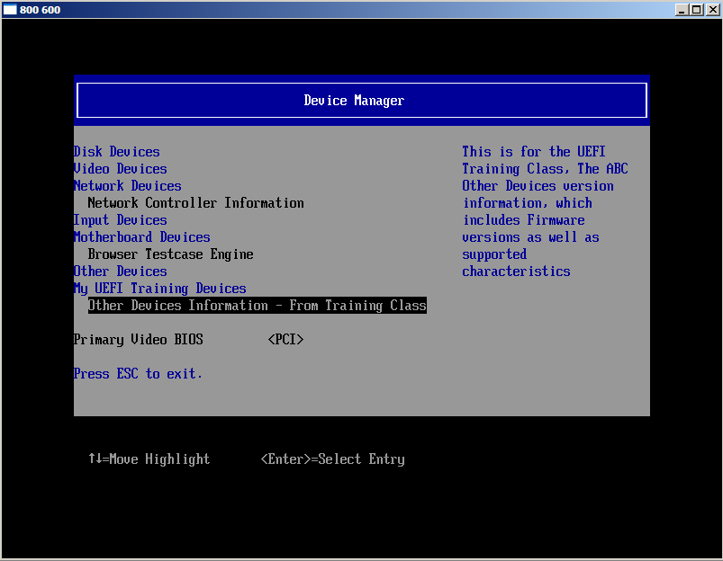
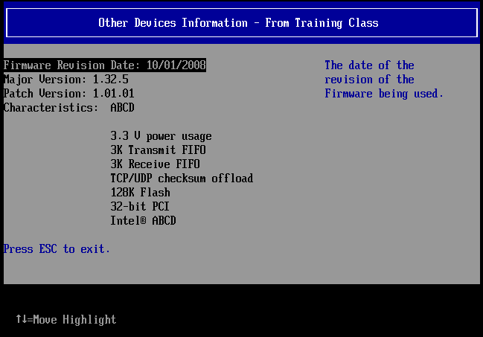
Add a setup form to the Device Manager

Slide 25
Adding a Setup form: Step-by-Step –Lab 2
Start with the UEFI 2.1 Browser DriverSample example Location in EDK I Sample\Universal\UserInterface\UefiSetupBrowser\Dxe\DriverSample
  Consumes protocols
    EFI_HII_DATABASE_PROTOCOL, EFI_HII_STRING_PROTOCOL, EFI_HII_CONFIG_ROUTING_PROTOCOL, EFI_FORM_BROWSER2_PROTOCOL
  Produces protocol EFI_HII_CONFIGURATION_ACCESS_PROTOCOL
    ExtractConfig, RouteConfig and Callback
Look at the Network and Motherboard Devices as examples
Hint: Class CD contains the finished Edits for this lab \Class\PlatformCustomization\Lab2

Slide 26
Adding a Setup form: Step-by-Step –
Create a new Otherdevice.UNI file that will contain the strings for your new setup form
Create a new Otherdevice.VFR file that will contain the new Formset
Add the new GUID Id to the NvDataStruc.h
Add the .VFR and .UNI files to the SampleDriver.INF file
Changes to SampleDriver.h
  Add the data structure needs to be referenced from the SampleDriver.h
  Add 1 additional handle and Driver handle for the Private Data structure in
Add changes DriverSample.c
  New GUID declaration
  Add additional entries for Hii Handles and DriverHandle to DriverSampleInit()
  Add the code for the new form in Otherdevices

Slide 27
Adding a Setup form: Step-by-Step
Create a new .UNI file that will contain the strings for your new setup form
  Add the following to Sample\Universal\UserInterface\UefiSetupBrowser\Dxe\DriverSample\OtherDevice.uni
#langdef en-US "English"
#langdef fr-FR "Francais"
#string STR_OD_FORM_SET_TITLE #language en-US "Other Devices Information - From Training Class"
#string STR_OD_FORM_SET_HELP #language en-US "This is for the UEFI Training Class, The ABC Other Devices version information, which includes Firmware versions as well as supported characteristics"
#string STR_OD_FORM1_TITLE #language en-US "ABC Other Controller Version Data"
#string STR_OD_VERSION_TEXT #language en-US "Firmware Revision Date: 10/01/2008"
#string STR_OD_VERSION_HELP #language en-US "The date of the revision of the Firmware being used."
#string STR_OD_VERSION_TEXT2 #language en-US "Major Version: 1.32.5"
#string STR_OD_VERSION_TEXT3 #language en-US "Patch Version: 1.01.01"
#string STR_OD_VERSION_TEXT4 #language en-US "Characteristics: ABCD“
#string STR_OD_VERSION_TEXT5 #language en-US " 3.3 V power usage"
#string STR_OD_VERSION_TEXT6 #language en-US " 3K Transmit FIFO"
#string STR_OD_VERSION_TEXT7 #language en-US " 3K Receive FIFO"
#string STR_OD_VERSION_TEXT8 #language en-US " TCP/UDP checksum offload"
#string STR_OD_VERSION_TEXT9 #language en-US " 128K Flash"
#string STR_OD_VERSION_TEXT10 #language en-US " 32-bit PCI"
#string STR_OD_VERSION_TEXT11 #language en-US " Intel® ABCD"
#string STR_OD_VERSION_TEXT12 #language en-US "Press ESC to exit."
#string STR_OD_EMPTY_STRING #language en-US ""

Slide 28
Adding a Setup form: Step-by-Step
Create a new .VFR file that will contain the strings for your new setup form
  Add the following to Sample\Universal\UserInterface\UefiSetupBrowser\Dxe\DriverSample\OtherDevice.VFR
#include "DriverSampleStrDefs.h"
#define OTHER_DEVICE_GUID { 0xef7121de, 0x3eee, 0x4ebf, 0x9c, 0x9, 0x6f, 0xa7, 0x6a, 0x5d, 0x11, 0x19 }
formset
guid = OTHER_DEVICE_GUID,
title = STRING_TOKEN(STR_OD_FORM_SET_TITLE),
help = STRING_TOKEN(STR_OD_FORM_SET_HELP),
class = 0x80,
subclass = 0x03,
form formid = 1,
title = STRING_TOKEN(STR_OD_FORM1_TITLE); // note formid is a variable (for readability)
Notes:
DriverSampleStrDefs.h is automatically generated
Generate a New GUID
Class = same as our class in previous lab
Subclass = EFI_SETUP_APPLICATION_SUBCLASS

Slide 29
Adding a Setup form: Step-by-Step
Continued
text
help = STRING_TOKEN(STR_OD_VERSION_HELP),
text = STRING_TOKEN(STR_OD_VERSION_TEXT),
text = STRING_TOKEN(STR_OD_EMPTY_STRING),
flags = 0,
key = 0;
text
help = STRING_TOKEN(STR_OD_EMPTY_STRING),
text = STRING_TOKEN(STR_OD_VERSION_TEXT2),
text = STRING_TOKEN(STR_OD_EMPTY_STRING),
flags = 0,
key = 0;
text
help = STRING_TOKEN(STR_OD_EMPTY_STRING),
text = STRING_TOKEN(STR_OD_VERSION_TEXT3),
text = STRING_TOKEN(STR_OD_EMPTY_STRING),
flags = 0,
key = 0;
text
help = STRING_TOKEN(STR_OD_EMPTY_STRING),
text = STRING_TOKEN(STR_OD_VERSION_TEXT4),
text = STRING_TOKEN(STR_OD_EMPTY_STRING),
flags = 0,
key = 0;
subtitle text = STRING_TOKEN(STR_OD_EMPTY_STRING);
text
help = STRING_TOKEN(STR_OD_EMPTY_STRING),
text = STRING_TOKEN(STR_OD_VERSION_TEXT5),
text = STRING_TOKEN(STR_OD_EMPTY_STRING),
flags = 0,
key = 0;
. . . Add “text” statements 6 - 10
text
help = STRING_TOKEN(STR_OD_EMPTY_STRING),
text = STRING_TOKEN(STR_OD_VERSION_TEXT11),
text = STRING_TOKEN(STR_OD_EMPTY_STRING),
flags = 0,
key = 0;
subtitle text = STRING_TOKEN(STR_OD_EMPTY_STRING);
subtitle text = STRING_TOKEN(STR_OD_VERSION_TEXT12);
endform;
endformset;

Slide 30
Adding a Setup form: Step-by-Step
Add the new GUID Id to the NvDataStruc.h (NOTE: make sure there are no spaces at the end of the “\” for line continuation – GUID should be the same as in the .VFR file)
Add the .VFR and .UNI files to the SampleDriver.INF file
#define INVENTORY_GUID \
{ \
0xb3f56470, 0x6141, 0x4621, 0x8f, 0x19, 0x70, 0x4e, 0x57, 0x7a, 0xa9, 0xe8 \
}
// {EF7121DE-3EEE-4ebf-9C09-6FA76A5D1119}
#define OTHER_DEVICE_GUID \
{ \
0xef7121de, 0x3eee, 0x4ebf, 0x9c, 0x9, 0x6f, 0xa7, 0x6a, 0x5d, 0x11, 0x19 \
}
[sources.common]
OtherDevice.uni
OtherDevice.vfr
InventoryStrings.uni
Inventory.vfr
VfrStrings.uni
Vfr.vfr
DriverSample.c
DriverSample.h

Slide 31
Adding a Setup form: Step-by-Step
The build tools will create a data structures from the Form .VFR and Strings .UNI files. This data structure needs to be referenced from the SampleDriver.h files
Add 1 additional handle and Driver handle for the Private Data structure in SampleDriver.h
// This is the generated IFR binary data for each formset defined in VFR.
// This data array is ready to be used as input of PreparePackageList() to
// create a packagelist (which contains Form packages, String packages, etc).
extern UINT8 VfrBin[];
extern UINT8 InventoryBin[];
extern UINT8 OtherDeviceBin[];
typedef struct {
UINTN Signature;
EFI_HANDLE DriverHandle[3];
EFI_HII_HANDLE HiiHandle[3];
DRIVER_SAMPLE_CONFIGURATION Configuration;
UINT8 PasswordState;

Slide 32
Adding a Setup form: Step-by-Step
Add the following changes to DriverSample.c – New GUID declaration
Add additional entries for Hii Handles and DriverHandle to DriverSampleInit() ~ln 540
Add the code for the new form in Otherdevices to //Publish another Fromset ~ln 690
EFI_GUID mFormSetGuid = FORMSET_GUID;
EFI_GUID mInventoryGuid = INVENTORY_GUID;
EFI_GUID mOtherDeviceGuid = OTHER_DEVICE_GUID;
DriverSampleInit (
IN EFI_HANDLE ImageHandle,
IN EFI_SYSTEM_TABLE *SystemTable
)
{
EFI_STATUS Status;
EFI_STATUS SavedStatus;
EFI_HII_PACKAGE_LIST_HEADER *PackageList;
EFI_HII_HANDLE HiiHandle[3];
EFI_HANDLE DriverHandle[3];
Status = CreateHiiDriverHandle (&DriverHandle[2]);
if (EFI_ERROR (Status)) {
return Status;
}
PrivateData->DriverHandle[2] = DriverHandle[2];
PackageList = PreparePackageList (
2,
&mOtherDeviceGuid,
DriverSampleStrings,
OtherDeviceBin
);
if (PackageList == NULL) {
return EFI_OUT_OF_RESOURCES;
}
Status = HiiDatabase->NewPackageList (
HiiDatabase,
PackageList,
DriverHandle[2],
&HiiHandle[2]
);
gBS->FreePool (PackageList);
if (EFI_ERROR (Status)) {
return Status;
}
PrivateData->HiiHandle[2] = HiiHandle[2];
NOTE: New are mOtherDeviceGuid OtherDeviceBin

Slide 33
Adding a Setup form String: Step-by-Step
Customizing Lab
Save all files and Build
In the Command prompt window:
  CD C:\Fw\Edk\Sample\Platform\Nt32\
  Build
After the build process successfully completes
  CD Uefi
  nmake run
Select the “Device Manager” menu
You will see the new device item in the menu
Select the “Other Devices Information - From Training Class” and the new menu will be displayed

Slide 34
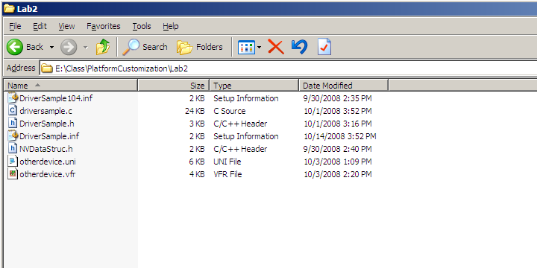
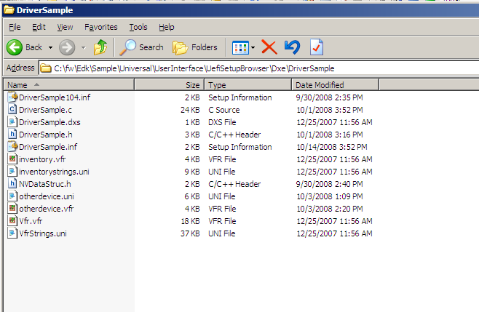
If Errors on Lab 2
Copy the files on the Lab CD

Slide 35
Extra Credit Lab
Use the existing example SampleDriver to make some of the new menu selections interactive.

Slide 36
Summary
Customizing Lab
Debug an EFI application or framework driver just like a normal Windows application
  Debug applications in Visual Studio
  Continue running the application to next breakpoint
  Quick turnaround to verify a fix
  Exit emulation
  Modify code, recompile and launch application
Modularity
  Binary compatibility of framework between platforms allows for new development environment supporting modern software practices.
Reduce Time To Market (TTM)
  Development and test of hardware independent portions with modern and common tools.
  Allows vendors to share drivers and applications

Slide 37
Additional Resources
Class CD - Documents
  Framework R8.x Build.pdf describes build tools
https://www.TianoCore.org
  Website for EFI open source resources
    EFI Developer Kit (EDK)
      Nt32 emulation environment
    EFI Shell https://efi-shell.tianocore.org/

Slide 38




Q & A

Slide 39


Slide 40

Back up
Back Up

